Slide 1
Customer Churn Prediction
Ji Wu
Ram Swaroop

Slide 2
Contents
Introduction
Exploratory Data Analysis
Data Cleaning and pre-processing
Data Modelling
Applications

Slide 3
Introduction
Goal – The goal of the project is to predict the customer behavior by analyzing appropriate customer data.
About the Dataset – The dataset is of a telecom company which has
Customer data like their age, gender, number of dependents.
The services used by the customer like phone, internet, tech support.
Customers who left within the last month (churn).

Slide 4
Dataset Overview
The dataset has 7043 rows and 21 columns.
The variables are:
customerID, gender, SeniorCitizen, Partner, Dependents, tenure, PhoneService, MultipleLines, InternetService, OnlineSecurity, OnlineBackup, DeviceProtection, TechSupport, StreamingTV StreamingMovies, Contract, PaperlessBilling, PaymentMethod, MonthlyCharges, TotalCharges, Churn
Churn is a categorical variable with Yes or No value.

Slide 5
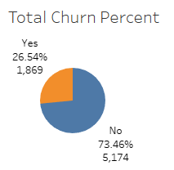
Exploratory Data Analysis
There are total of 7043 customers.
Out of which 1869 (26.54%) have left the service.

Slide 6
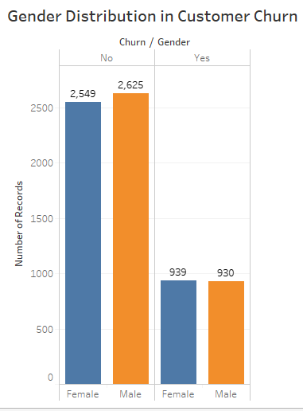
Exploratory Data Analysis
The customer churn is almost uniform with respect to gender.
Out of 1869 churn customers 930 are male and 939 are female.

Slide 7
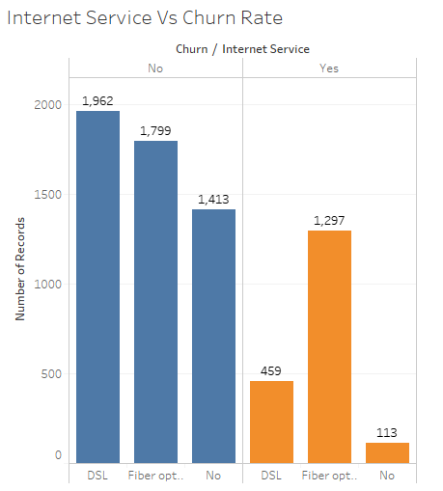
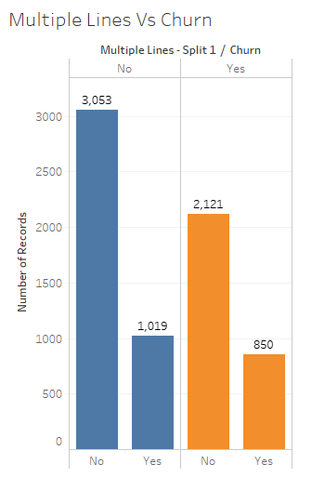
Exploratory Data Analysis

Slide 8
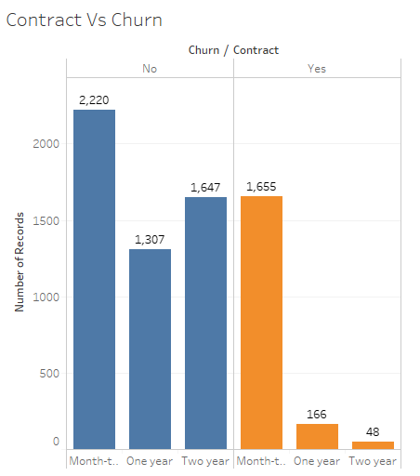
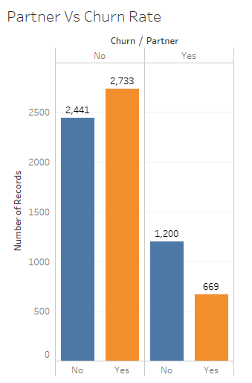
Exploratory Data Analysis

Slide 9
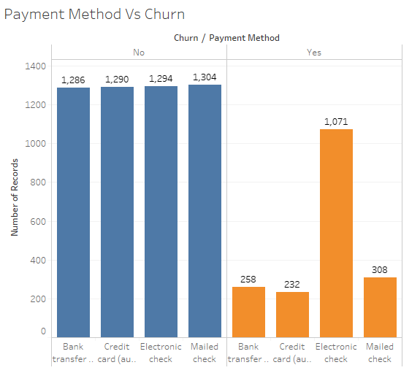
Exploratory Data Analysis
More than 1000 people who used Electronic check have left the service

Slide 10
Data Cleaning and Pre-Processing
Data cleaning involves following steps:
To check if any missing values in the dataset.
Encoding the categorical variables with 2 or multiple values.
Data Pre-processing involves following steps:
Scaling the numerical values.
Dividing the dataset into dependent and independent variables.
Splitting the dataset into Train and Test.

Slide 11
Data Cleaning and Pre-Processing
To check if there are any missing values in the dataset.
df_isnull = df.isnull().values
To replace missing values in TotalCharges with the mean.
df['TotalCharges'] = df["TotalCharges"].replace(" ",np.nan)
df["TotalCharges"] = df["TotalCharges"].astype(float)
df['TotalCharges’]=df['TotalCharges'].fillna((df['TotalCharges'].mean()))

Slide 12
Data Cleaning and Pre-Processing
MultipleLines, OnlineSecurity, OnlineBackup, DeviceProtection,
TechSupport, StreamingTV, StreamingMovies have 3 categories each.
No service is equal to No.
Replacing No service with No.
df['StreamingTV'] = df['StreamingTV'].replace(['No internet service'], 'No’)
All the variables have been replaced using the same method.

Slide 13
Data Cleaning and Pre-Processing
Using the map function to map Yes and No values to 1 and 0
d = {'Yes':1 , 'No': 0}
df['Churn'].map(d)
The above method is used for all the categorical variables with 2 values.

Slide 14
Data Cleaning and Pre-Processing
Encoding the columns with two or more values.
Label Encoder class from sklearn library is used for columns with two categories.
Pd.get_dummies method is used for columns with more than two categories.

Slide 15
Data Cleaning and Pre-Processing
Scaling the numerical columns
To compare two variables ‘Total charges’ and ‘Monthly charges’ which are measured different scales.
The variables are normalized into a range from -1 to +1.
Scaling is done using Standard Scaler available in sklearn library.
from sklearn.preprocessing import StandardScaler
sc = StandardScaler()

Slide 16
Data Cleaning and Pre-Processing
Dividing the columns into dependent and independent variable.
y = df.iloc[:, 13].values
x= df.drop('Churn’,1)
Splitting the data into Test and Train
from sklearn.model_selection import train_test_split
x_train, x_test, y_train, y_test = train_test_split(x, y, test_size = 0.2)

Slide 17

Classification
Classification is the process of predicting a class of a datapoint.
In our project customer churn is predicted.
We have used Logistic Regression, Decision Tree and Random Forest models to classify the customer churn.

Slide 18
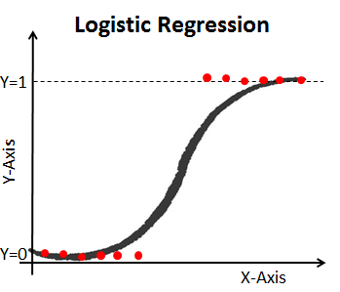
Logistic Regression
The curve is the fit to the data to predict the probability a customer would churn or not.
The Y axis is the probability of the dependent variable from 0 to 1.
The X axis are the independent variables.

Slide 19
Logistic Regression
The Y axis in logistic regression is transformed from the probability of churn to the log (odds of churn).
Now Y axis can go from -Infinity to +Infinity(Similar to Regression).
This is done using the logit function. Given by log(p/1-p).
Maximum likelihood is used to find the best fitting line.

Slide 20
Fitting the Model
The code for logistic regression model
from sklearn.linear_model import LogisticRegression
classifier = LogisticRegression(random_state = 0)
classifier.fit(x_train, y_train)
Predicting the Test set results
y_pred = classifier.predict(x_test)

Slide 21

Confusion Matrix
The confusion matrix helps in finding the accuracy and precision of the model
from sklearn.metrics import confusion_matrix
cm = confusion_matrix(y_test, y_pred)
Confusion matrix for Logistic Regression

Slide 22


Confusion Matrix
Accuracy is given by : True Positive + True Negative/ Total
Precision is a measure that tells us what proportion of customers we analyzed as churn customers, actually left the company.

Slide 23
Random Forest and Decision Tree
Random forest consists of a large number of individual decision trees that operate as an ensemble.
Each individual tree in the random forest spits out a class prediction and the class with the most votes becomes our model’s prediction.

Slide 24
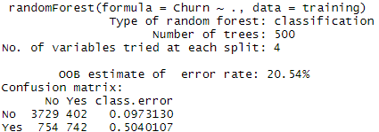
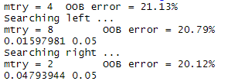
Tuning the model

Slide 25

Confusion Matrix
Confusion Matric for Random Forest
Accuracy of Random Forest model is 0.8412

Slide 26
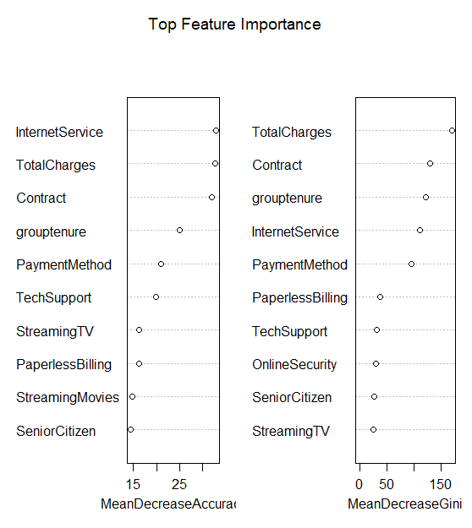
Total Feature Importance

Slide 27
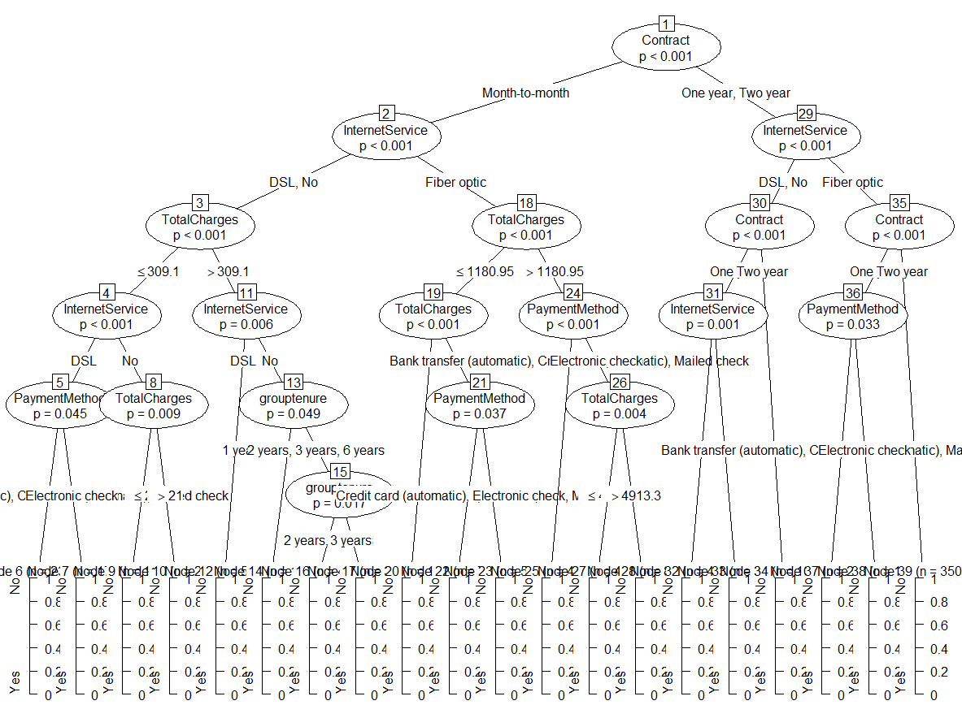
Decision Tree

Slide 28
Applications and Conclusion
Customer Churn prediction is helpful in determining customer lifetime value.
Can be useful in personalized marketing and CRM.
Churn prediction can help in retaining customers.
In conclusion Random Forest model has higher accuracy than Logistic Regression model

Slide 29
Thank you

